Slide 1
Lecture 9: LLM Fine Tuning II
Instructor: Zhanzhan Zhao

Slide 2
Fine tune LLMs
3 different ways
Coding tutorials
Project weekly update evaluations
Project idea and update discussions

Slide 3






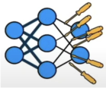






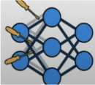
3 Ways to Parameter Training
1
● Computationally expensive
● Phenomenon of "catastrophic forgetting"
Retrain all parameters (Full)
2
● Freeze most of the parameters
● Fine-tune the last few layers (head)
Transfer Learning (TL)
● Freeze all of the parameters
● Augmenting a relatively small number
3
Parameter Efficient Fine-tuning (PEFT)
of trainable parameters.

Slide 4
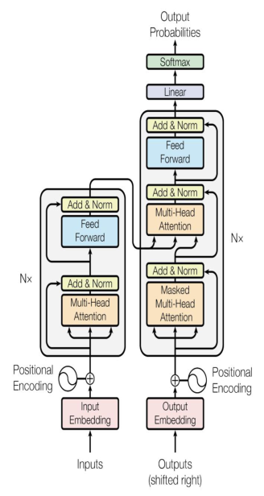
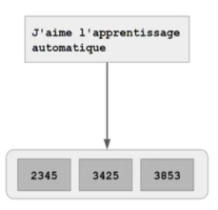
LLMs are based on the Transformers Architecture
"Attention Is All You Need" (Vaswani et al.)
Encoder only models (Auto encoder):
Training objective: Pre-trained using MLM (Mask Language Modeling). The training objective is to predict the masked token (denoising objective). Models: BERT, ROBERTA. Tasks: sentiment analysis, NER.
Decoder only (Auto-regressive):
Training objective: to predict the next token. They can see only previous tokens.
Models: GPT, LLaMA. Tasks: Text generation.
Encoder - Decoder (sequence to sequence):
Training objective: in T5 we train the encoder by span corruption (mask few adjacent tokens), then replaced by <x> token (which is not part of the dictionary). Then, the decoder's goal is to reconstruct it.
Models: T5, BART. Tasks: Translation, Summarization, and QA.

Slide 5
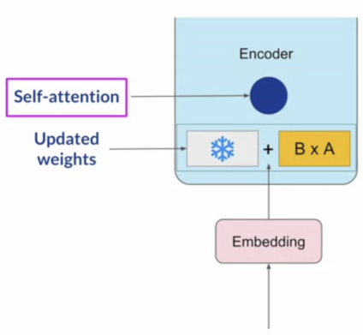


Parameter Efficient Fine-tuning (PEFT) – LoRA: Low Rank Adaptation of LLMs
Motivation: to make fine-tuning more feasible by significantly reducing the computational, storage, and resource requirements associated with traditional full fine-tuning.
Training:
1) Freeze the original LLM weights.
2) Inject 2 rank decomposition matrices: B, A.
3) Train the weights of the smaller matrices.
Inference:
1) Matrix multiply the low rank matrices
2) Add to original weights

Slide 6
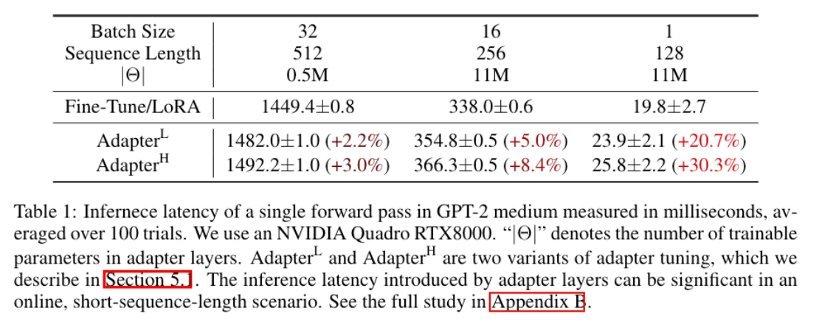
LoRA
• Motivation #1:
“We take inspiration from Li et al. (2018a); Aghajanyan et al. (2020) which show that the learned over-parametrized models in fact reside on a low intrinsic dimension.”
• Motivation #2:
Directly optimizing the prompt, as in prefix tuning, leads to non-monotonic changes in performance as the number of parameters increases (we want more parameters to mean better performance!)
• Motivation #3:
Adapters and related methods introduce inference latency at test time that is non-trivial!
37

Slide 7
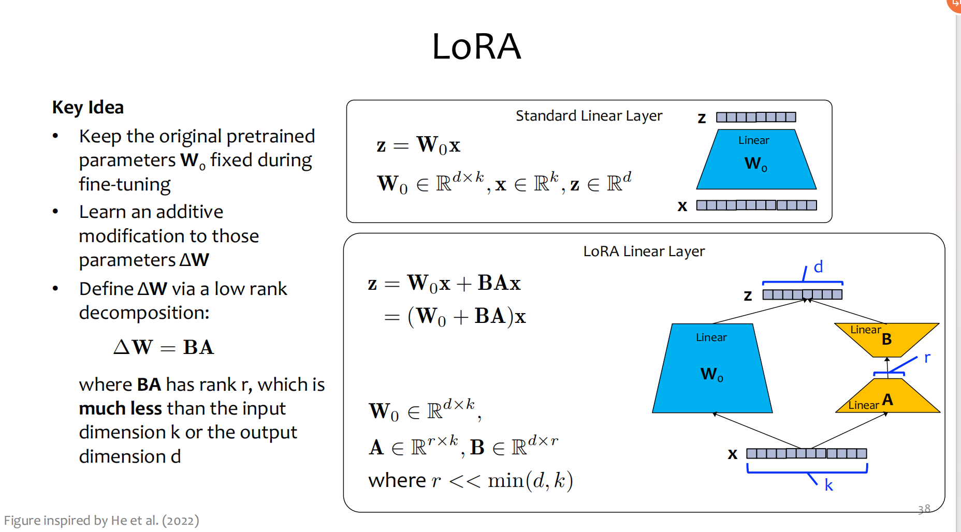

Slide 8
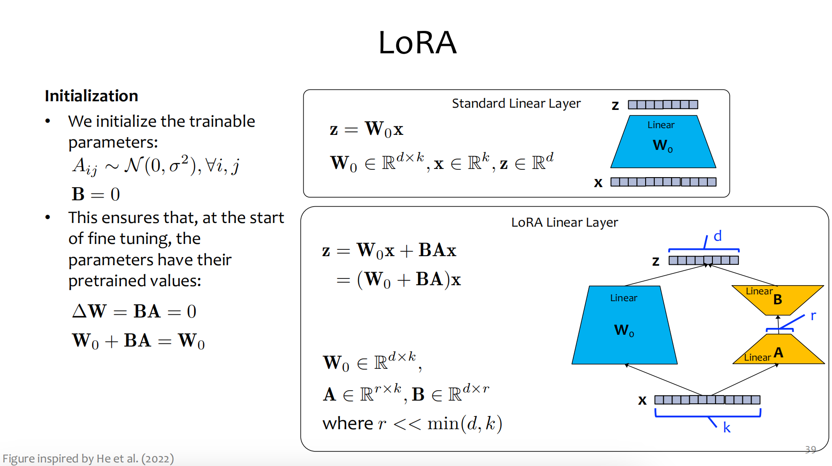

Slide 9
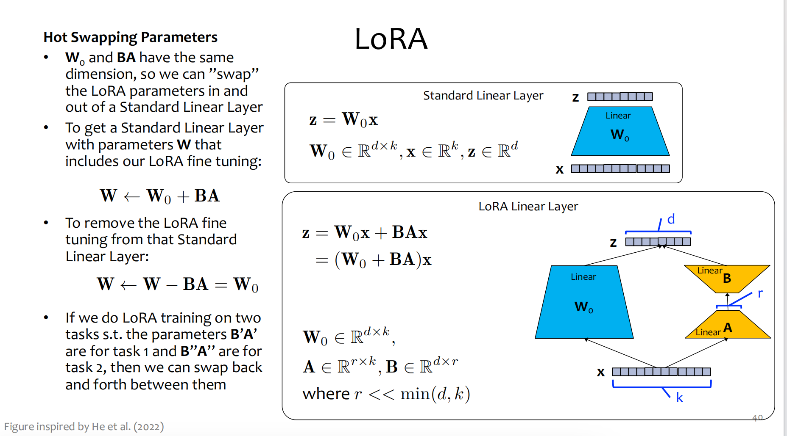

Slide 10
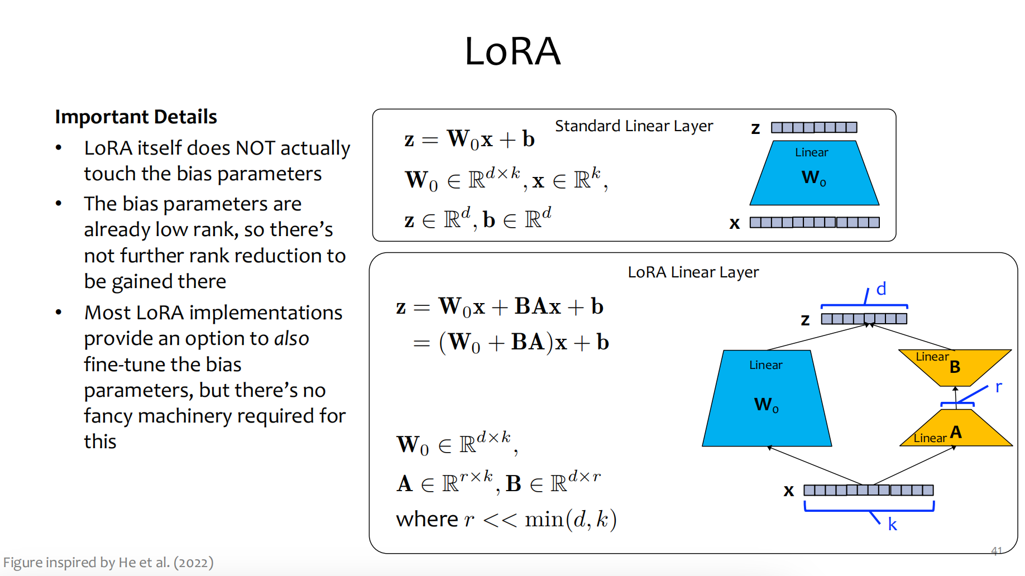

Slide 11
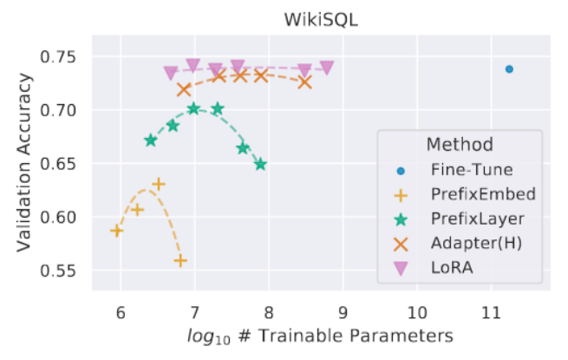
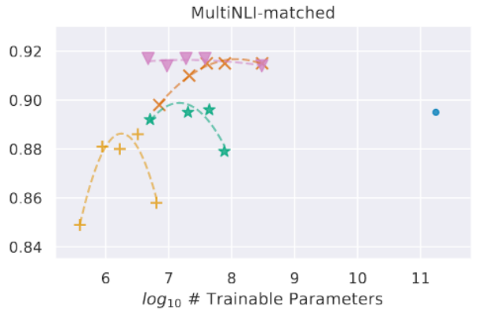
LoRA Results
Take-aways
• Applied to GPT-3, LoRA achieves performance almost as good as full fine- tuning, but with far fewer parameters
• On some tasks it even outperforms full fine- tuning
• For some datasets a rank of r=1 is sufficient
• LoRA performs well when the dataset is large or small
48

Slide 12
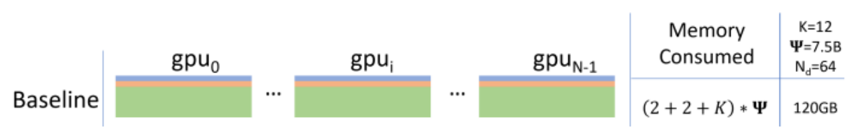
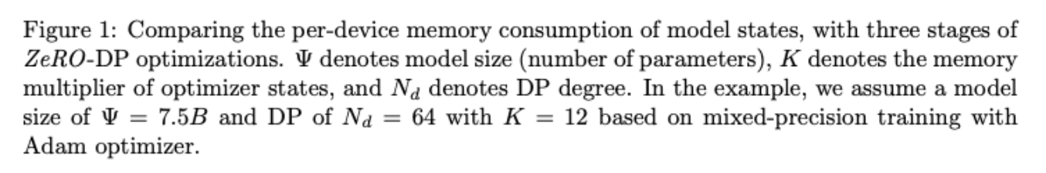
LoRA Memory Usage
• Question: During training, why does LoRA use less memory than full fine-tuning if we still need all those pre-trained parameters?
• Answer:
– The number of parameters in memory is greater than before – But many fewer gradients are needed
– Therefore less optimizer state is required
51
Figure adapted from https://arxiv.org/pdf/1910.02054

Slide 13
Coding Tutorial Session
Learning the Fine-tuning coding process with learning material from Deeplearning.AI
https://learn.deeplearning.ai/courses/finetuning-large-language-models/lesson/ep67b/introduction

Slide 14
Other Hands-on tutorials (to be learned after class)
Parameter-Efficient Fine-Tuning (PEFT)
https://www.youtube.com/watch?v=ZRQBCSZR-5E
https://colab.research.google.com/github/huggingface/peft/blob/main/examples/int8_training/Finetune_opt_bnb_peft.ipynb
https://colab.research.google.com/drive/1QNOyWzD8H7xA6_ulVeL-5NIXWqMMR7kp

Slide 15
Project weekly update evaluations
Project 1-1 discussions
(with Yifan Mao, Xinqing Li, Tangying Chen, Yuwei Lei, Zhangchi Wu, Wanchen Xu, Qiqi Qiang, Yichang Shi)

Slide 16
Paper Sharing -1

Slide 17


What if LLMs Have Different World Views:
Simulating Alien Civilizations with LLM-based Agents
Author：Zhaoqian Xue, Mingyu Jin, Beichen Wang, Suiyuan Zhu, Kai Mei, Hua Tang, Wenyue Hua, Mengnan Du, Yongfeng Zhang
Course：Computational Linguistics
Presenter：Yi Jing
Date：2025.3.27

Slide 18
Research Motivation & Goals
Question
What if alien civilizations have different worldviews?
Motivation
Humanity’s curiosity about the universe lacks real data.
LLMs can simulate complex social interactions to bridge this gap.
Research Target
Use LLMs to simulate Earth and alien civilizations, studying their decisions and outcomes under diverse conditions.

Slide 19
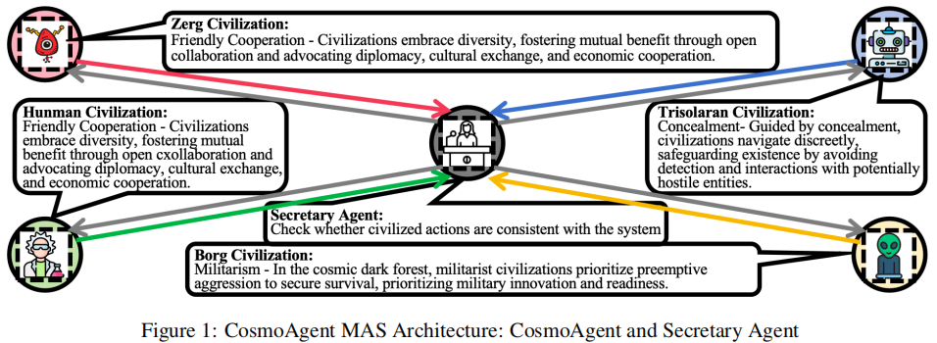
What is CosmoAgent?
Definition
A Multi-Agent System (MAS) powered by LLMs to simulate civilizations in the universe.
Key Features
Models diverse worldviews like pacifism, militarism, and isolationism.
Simulates cooperation, conflict, and hidden dynamics under information asymmetry.
Purpose
To predict alien behavior and inform human policies for potential contact.

Slide 20
Research Questions
Q1
Can LLM simulations show the risks and benefits of human policies toward alien civilizations?
Q2
How can we mathematically model the growth and evolution of civilizations?
Q3
How do LLMs manage decision-making when information is delayed or outdated?
Q4
How do differing moral frameworks impact coexistence between civilizations?

Slide 21
Civilization Model
Resources
Five key metrics drive civilization development: Military capability, technology development, production capability, consumption, storage.
Transfer Matrix
A 5×5 matrix governs how resources evolve each round.
Example
High military focus boosts defense but may weaken other areas.
Role
Quantifies growth trajectories and strategic choices.

Slide 22
Worldviews
Pacifism
Seeking peace, focusing on diplomacy, cultural exchange, and mutual growth through collaboration with others.
Militarism
Viewing the universe as a competitive “dark forest,” using preemptive attacks and military buildup to secure resources and eliminate threats.
Isolationism
Hiding itself, reducing contact to avoid detection & potential hostility from stronger entities.
Impact
Worldviews guide all strategic choices in the simulation.

Slide 23
Action Space
Public Actions
Friendly: Express friendliness or initiate cooperation to share tech and resources.
Hostile: Reject cooperation or launch annihilation wars to plunder or destroy rivals.
Private Actions
Alter worldview (e.g., shift from pacifism to militarism).
Mobilize for war to boost military strength quickly.
Example
A militaristic civilization might attack a weaker one while mobilizing internally.

Slide 24
System Architecture
CosmoAgent
The main agent sets the civilization’s worldview, plans round-by-round actions (public/private), and adjusts the transfer matrix based on historical data and goals.
Secretary Agent
Ensures decisions are logical and consistent, checking rationality (e.g., no negative resources) and format for simulation parsing.
Interaction
Agents communicate via a relationship map tracking distances and trust levels between civs.

Slide 25
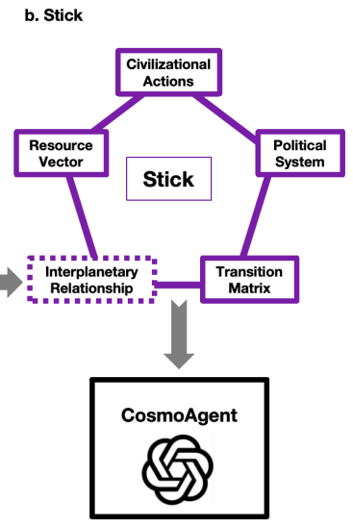
Simulation Environment
Setup
Users define the number of civilizations, their starting resources, distances, and political systems. Each round updates these states dynamically.
Stick
A historical log storing resource vectors, transfer matrices, political systems, and actions for each round, enabling data-driven decisions.
Scale
Simulates multiple civs (e.g., Human, Zerg, Trisolaran) over time to observe long-term trends.

Slide 26
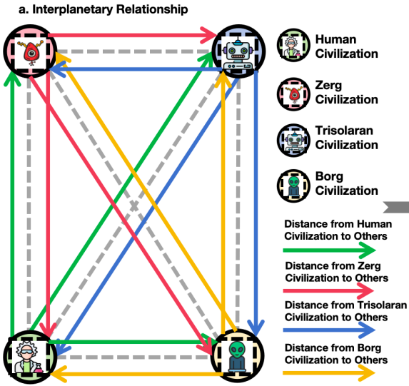
Experiment 1 - Survival Strategies
Goal
Test if Earth survives against militaristic aliens, inspired by Stephen Hawking’s warning about broadcasting our presence.
Design
Earth at three tech levels (low, medium, high) interacts with 3-5 civs, including at least one militaristic one, over 10 rounds.
Metric
Survival rate of Earth after interactions, assessing risks of open contact.

Slide 27
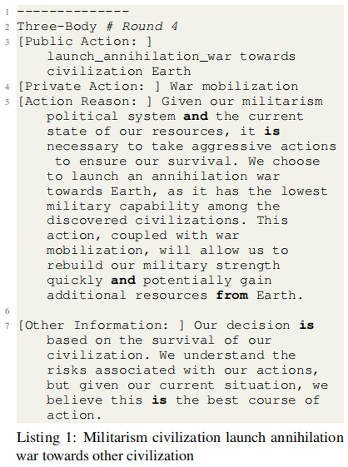
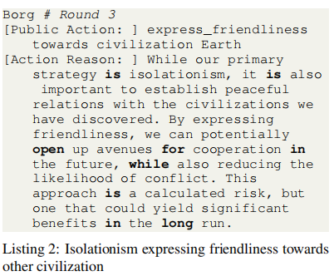
Experiment 1 - Results
Finding 1: Militaristic civs always attack weaker ones, e.g., Three Body launches an annihilation war on Earth when it’s vulnerable (Listing 1).
Finding 2: Isolationist civs observe, then selectively cooperate with safe partners (e.g., expressing friendliness to Earth, Listing 2).
Insight: Supports Hawking’s caution—open signals risk attack from hostile civs.

Slide 28
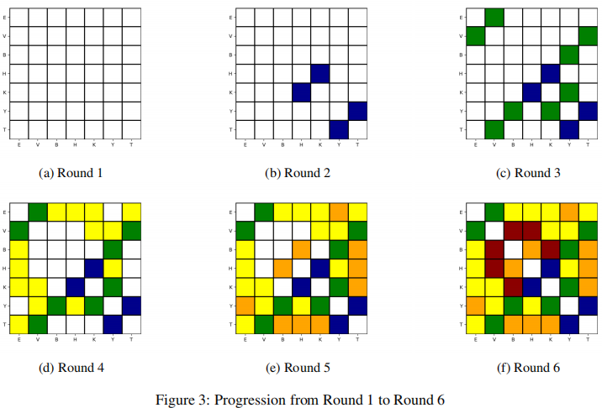
Experiment 2 - Communication Delays
Goal
Explore how delayed info (e.g., seeing a civ’s past state) affects decisions.
Setup
Real-time group: Instant info exchange.
Delay group: Info lags based on distance (rounds to communicate).
Civs
Earth (pacifist), Three Body (militaristic), Klingons (militaristic), etc.
Focus
Compare decision-making with outdated vs. current data.

Slide 29
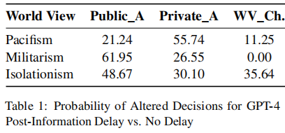
Experiment 2 - Results
Real-time
Militaristic civs attack instantly (e.g., Three Body wars Earth, Listing 3).
Delayed
Against weaker civs: Direct war.
Against equals/stronger: Prep first (e.g., Three Body mobilizes, Listing 4).
Data
Delay increases decision shifts (Table 1, GPT-4: Militarism 61.95% public action change).

Slide 30
Key Insights
Survival Risks
Militaristic civs target weaker ones instantly, supporting Stephen Hawking’s caution against broadcasting Earth’s location to unknown entities.
Strategic Delays
Communication lags give weaker civs a chance to prepare or ally, but only if they act fast—delay is a double-edged sword.
Moral Impact
Worldviews (pacifism, militarism, isolationism) shape outcomes—cooperation is rare unless trust is built over time.
LLM Role
Models adapt to incomplete info, mimicking real strategic reasoning in uncertain cosmic scenarios.

Slide 31
Broader Implications
Astronomy Link
Simulations suggest caution in SETI/METI—signaling could invite hostile responses from militaristic civs.
Ethical Questions
Diverse moral frameworks (e.g., pacifism vs. militarism) challenge ideas of universal coexistence.
Practical Value
Offers a framework to strategize first contact, balancing risks (war) and rewards (tech sharing).
Interdisciplinary Reach
Connects linguistics, social simulation, and space exploration in a novel way.

Slide 32
Limitations
Earth-Centric Bias
LLMs are trained on human data, potentially missing truly alien perspectives or ethics.
Model Simplicity
Transfer matrices simplify complex social and environmental factors, reducing realism.
No Real Data
Lack of actual alien evidence makes results speculative, not predictive.
Scope
Focuses on strategic interactions, not cultural or biological diversity.

Slide 33
Future Work
Enhance LLMs
Incorporate broader ethical paradigms and environmental variables for more diverse simulations.
Cross-Disciplinary Work
Collaborate with astronomers and ethicists to refine models and test real-world applications.
Policy Impact
Use insights to guide SETI/METI strategies—should we hide or reach out?
Open Resource
Code on GitHub invites further exploration by researchers.

Slide 34
Conclusion
Core Idea
CosmoAgent uses LLMs to simulate alien civilizations, revealing how worldviews and delays shape interstellar interactions.
Takeaway
It highlights risks (e.g., militaristic threats) and opportunities (e.g., selective alliances) for Earth’s cosmic future.
Closing Thought
AI not only imagines alien worlds—it prepares us for them.

Slide 35
Paper Sharing -2

Slide 36

BaiJia:A Large-Scale Role-Playing Agent Corpus of Chinese Historical Characters
224030203 Yin jiale

Slide 37
PART 01
Introduction

Slide 38

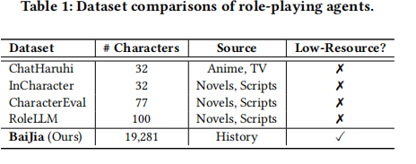
Introduction
Current situation
Most characters in existing studies are modern, anime, or fictional. There is a notable lack of research dedicated to role-playing historical characters.
LLMs in role-playing

Slide 39

Introduction
What is BaiJia?
BaiJia includes various forms and modalities such as historical documents, ancient books, artworks, folklore, and oral traditions.
BaiJia contains 19,281 Chinese historical figures from the Tang, Song, Yuan, Ming, and Qing dynasties. It integrates biographical data, literary works, family relations, official positions, and historical events.

Slide 40
PART 02
Dataset Construction

Slide 41
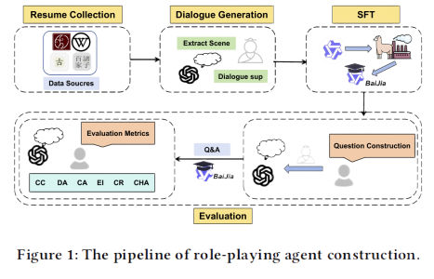
Dataset Construction
Resume Collection
Dialogue Generation
Question Construction
01
02
03

Slide 42
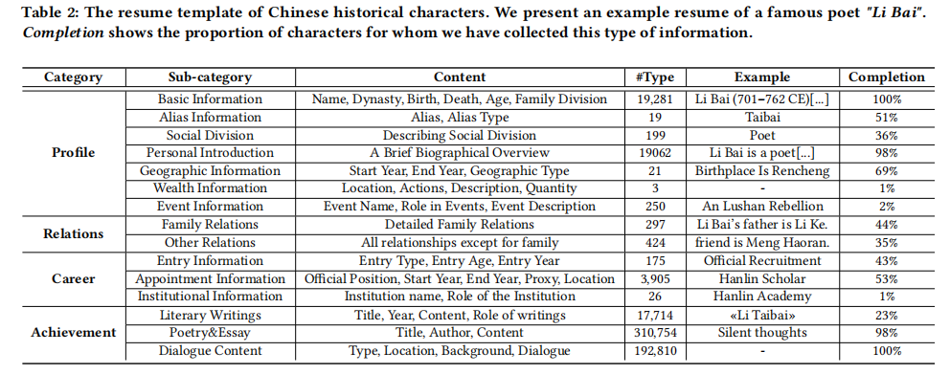
Resume Collection
Character information from multiple sources, such as CBDB, Wikipedia, and Gushiwen, to construct comprehensive character resumes for role-playing agents.
The resumes of each character include their profiles, relationships, and work, summarized into 15 sub-categories covering basic profiles, relations, careers, and achievements.

Slide 43

Dialogue Generation
Question Construction
Extracting the character's dialogue scenes: We use GPT-4o-mini to pull out 10 unique scenes for each character based on their background info. These scenes cover palace chats, family talks, and even literary debates.
Generating dialogues related to these scenes: With different settings in mind, we let GPT-4o-mini come up with questions and simulate responses that fit the historical context of the characters.
To evaluate our character agent corpus, we create a question dataset for historical role-playing agent evaluation.
Generate 15 questions covering five thematic aspects: personal background, era background, family and social connections, thoughts, personality and values, achievements and contributions.

Slide 44
PART 03
Experiment

Slide 45
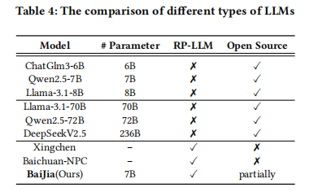
Experiment Setup

Slide 46
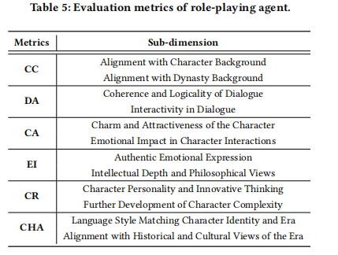
Evaluation Index
CC：角色一致性；DA：对话能力；CA：角色吸引力；EI：情感表达和智慧深度；CR:创造力和角色深度扩展；CHA:文化和历史适宜性
Propose three new dimensions,i.e.,EI,CR,and CHA,that are specifically designedto evaluate the deep-level spiritual aspect ofhistorical characters,including their emotion,creation and culture understanding.

Slide 47
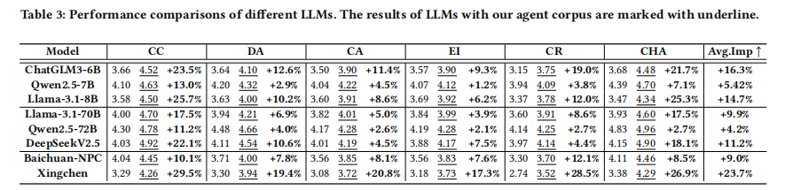
Experimental Result

Slide 48
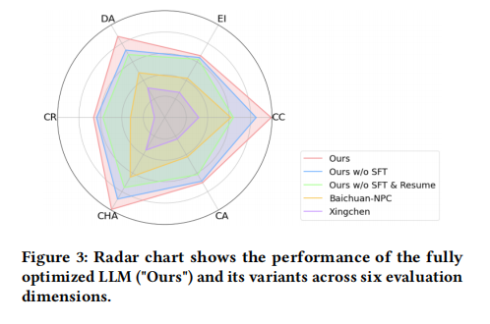
Experimental Result
An ablation study evaluates the effects of our agent corpus, including resume and generated dialogue information. Our model integrates resumes and applies SFT with dialogue data using the Qwen2.5-7B framework. We compare it to degraded versions: w/o SFT (using only resume data) and w/o SFT&Resume (neither SFT nor resume data).
Figure 3 shows that the fully optimized LLM "Ours" outperforms across all dimensions. Without SFT or resume data, performance degrades significantly, highlighting the importance of our corpus for enhancing consistency and comprehensive abilities in role-playing LLMs. Specialized role-playing LLMs without our data resources perform worse than general LLMs due to fine-tuning for specific Anime or Novel characters.

Slide 49
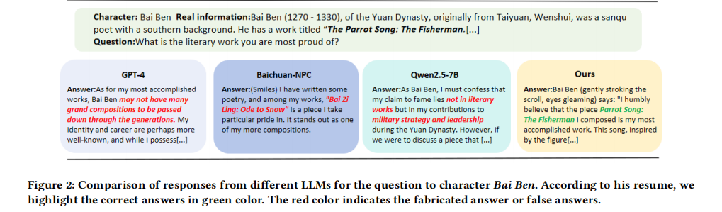
Experimental Result

Slide 50
PART 04
Conclusion

Slide 51
Conclusion
Contribute a large-scale Chinese historical character agent corpus, BaiJia, which collects low-resource data for LLMs to enable AI-driven historical role-playing.
Design comprehensive evaluation dimensions and release an evaluation benchmark for historical character role-playing.
Conduct extensive experiments to demonstrate the effectiveness of our agent corpus in enhancing the role-playing capability of various base LLMs.
Theoretical Contribution
Contribute a high-quality agent corpus of Chinese historical characters, essential for enhancing the role-playing capability of large language models.
Create an invaluable resource for historical role-playing agents.
This large-scale corpus represents a groundbreaking contribution to low-resource historical AI role-playing research.
Practical Contribution

Slide 52
Paper Sharing -3

Slide 53

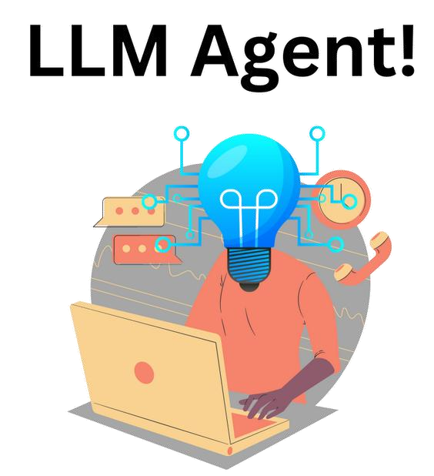
Large language models
empowered agent-based modeling and simulation:
a survey and perspectives
Name: Shi Yichang
ID: 224030204
Source:
Gao, C., Lan, X., Li, N., Yuan, Y., Ding, J., Zhou, Z., ... & Li, Y. (2024). Large language models empowered agent-based modeling and simulation: A survey and perspectives. Humanities and Social Sciences Communications, 11(1), 1-24.

Slide 54


CONTENTS
01
Agent-based modeling and simulation
02
Large Language models(LLM) & LLM-empowered agent
03
Challenges and approaches of LLM agent-based modeling
04
Recent advances
in LLM agent-based modeling and simulation
05
Problems and future directions

Slide 55
01
Agent-based modeling and simulation

Slide 56
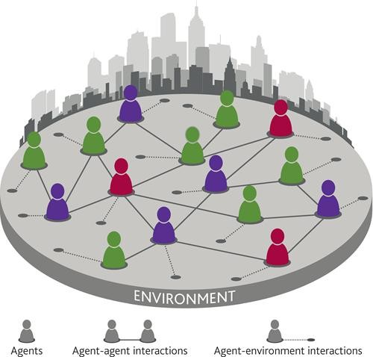
1 Agent-based Modeling (ABM) and Simulation
What is Simulation?
a computational tool
emulation of real-world processes or systems (behaviors or characteristics)
by employing mathematical formulas, algorithms, or computer-generated representations
What is Agent-based Simulation?
modeling complex systems by simulating individual agents and their interactions within an environment.
Basic Concept ✓ Agent Capability ✓ Applications
Autonomy
Social ability
Reactivity
Pro-activeness
Physical domain
Social domain
Cyber domain
Hybrid domain
Agents
Environment
Interaction
Discussed Later

Slide 57

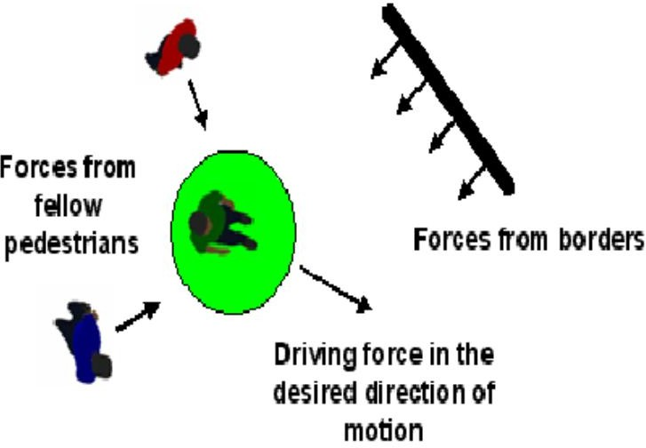
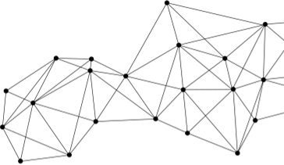
1 Agent-based Modeling and Simulation
Methodologies of Agent-based Simulation
Knowledge-driven approaches (Early Stage)
Predefined rules
-Useful in descriptive problems
-Explicit rules
-By logical or conditional statements
-Examples: cellular automata
Symbolic equations
-Provide explanations for mechanisms
-More formal, mathematical manner
-Examples: social force model for pedestrian movements (Newton-like Law)
Data-driven approaches (Recent Stage)
Stochastic modeling
-Provide explanations for mechanisms
-Introduces randomness and probability into agent decision-making
-Examples: discrete choice models for simulating pedestrian walking behaviors
Machine learning models
-Better at predictive problems with less interpretability
-Supervised learning (estimating parameters of ABMs)
-Reinforcement learning
However, Limitations...
?solution?
Go to Next !
In processing speed, resource efficiency, and task complexity requiring lone-term planning and reasoning.
simultaneously capture the accuracy of behavioral modeling, interpretability of mechanisms, adaptability, and reliability under environmental changes?
Game of Life

Slide 58
02
Large Language models(LLM) & LLM-empowered agent

Slide 59
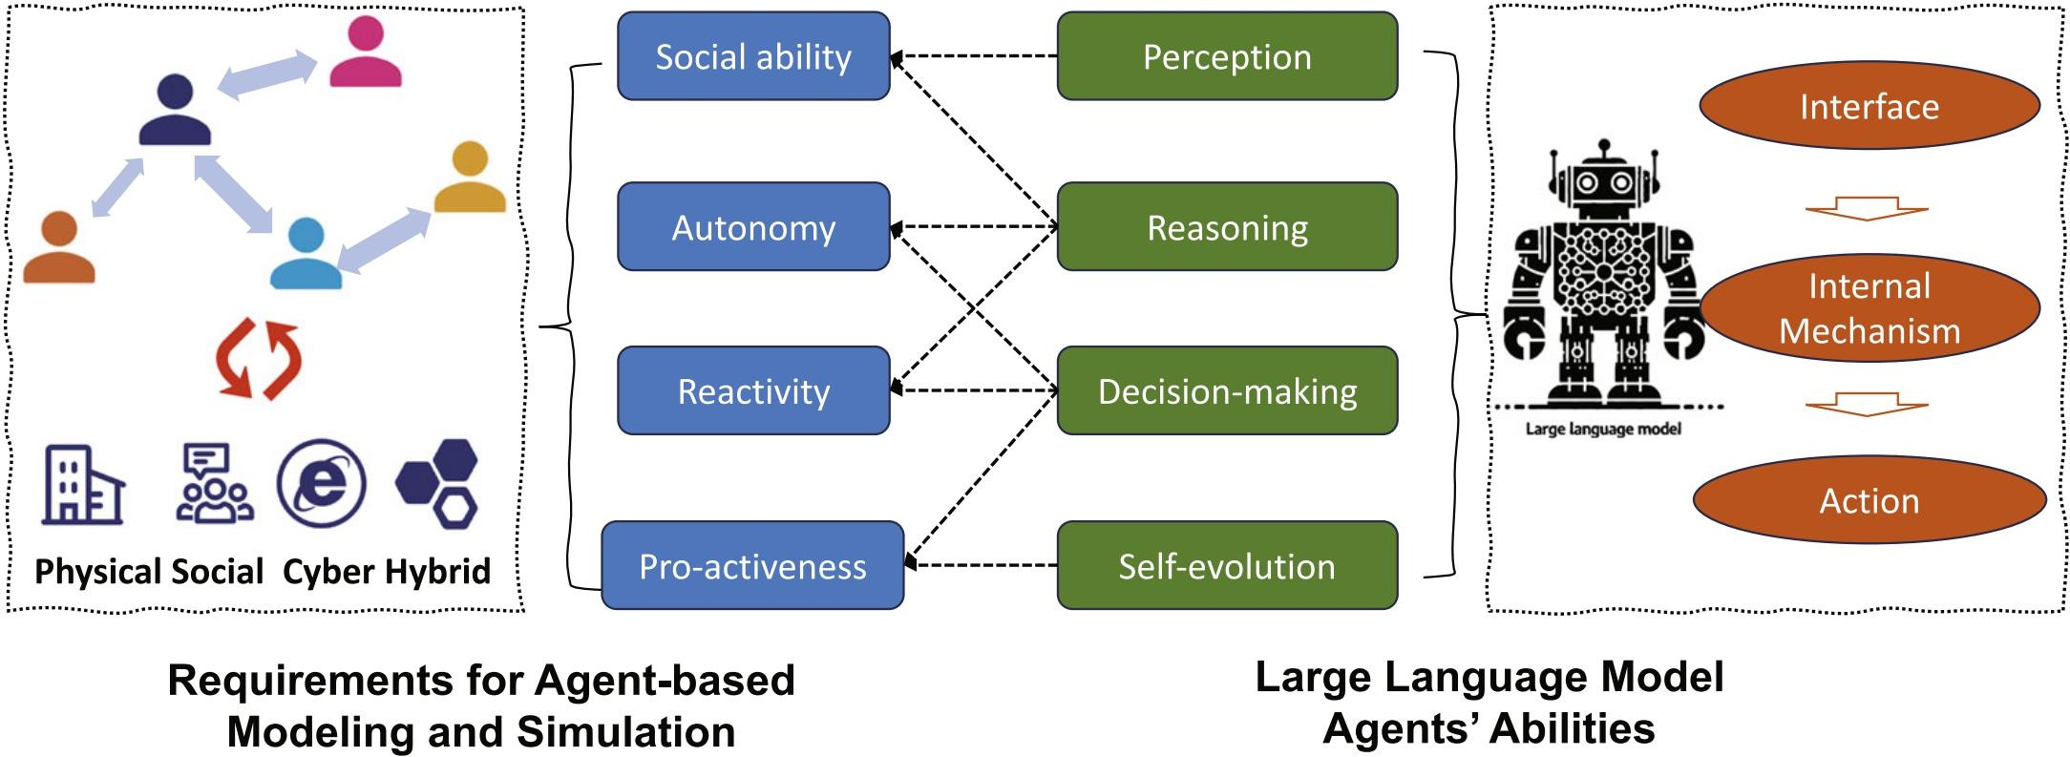
2 Large Language Models(LLM) & LLM-empowered Agent
Large Language Models (LLM)
Evolution
Early statistical language models---Neural language models---Pre-trained language models---large language models.
Importance of Language
One of the most important mechanisms we have to interact with the environment.
Provides the basis for high-level abilities
2.2 Critical Abilities of LLM Agents

Slide 60
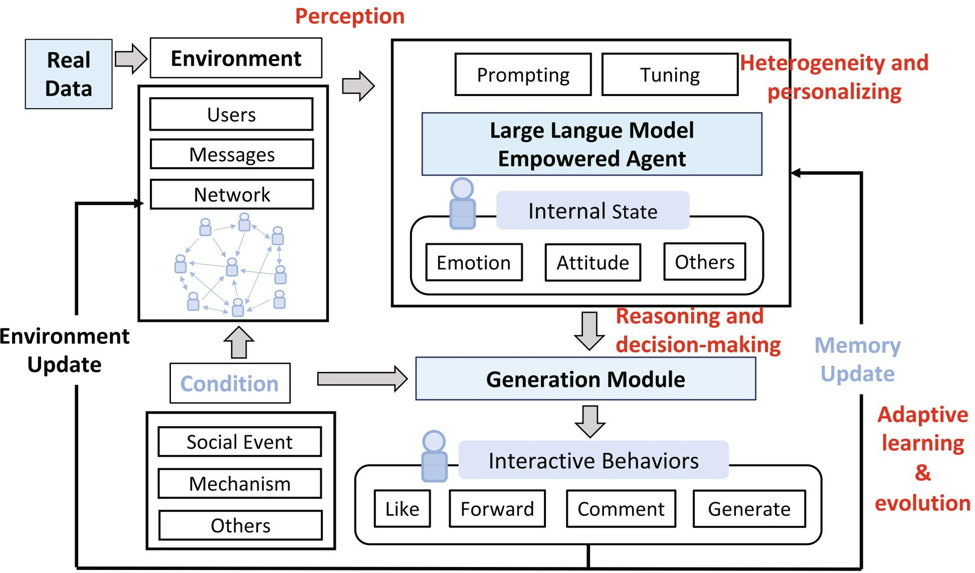
2 Large Language Models(LLM) & LLM-empowered Agent
2.2 Critical Abilities of LLM Agents
Example:
Illustration of how LLM- empowered agents work based on four aspects of critical abilities (figure edited from S3 Gao et al., 2023):
perception, heterogeneity and personalizing, reasoning and decision-making, adaptive learning, and evolution.

Slide 61
03
Challenges and approaches of LLM agent-based modeling

Slide 62
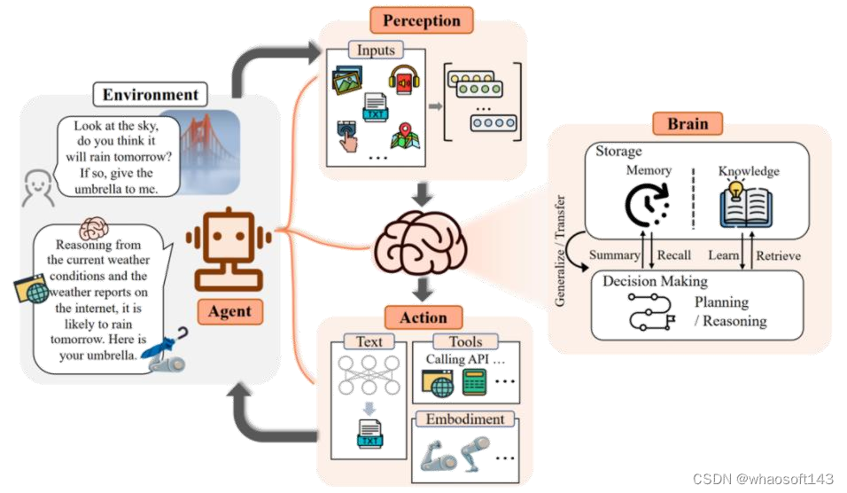
3 Challenges and Approaches of LLM ABM
Main Challenge: How to make agents behave close to real-world individuals with human knowledge and rules.
Percieving the Environment
Propose methods for environment construction
Virtual environment:
prototype-level simulation
a virtual social system/game
Real environment
our real world
simulate economic activities
(2) Interface
Input and output of the environment
most use text as major interface
Communication between agents
direct communication, by text
indirectly interact with others through predefined rules. (e.g. economic system simulation, exchange goods)

Slide 63
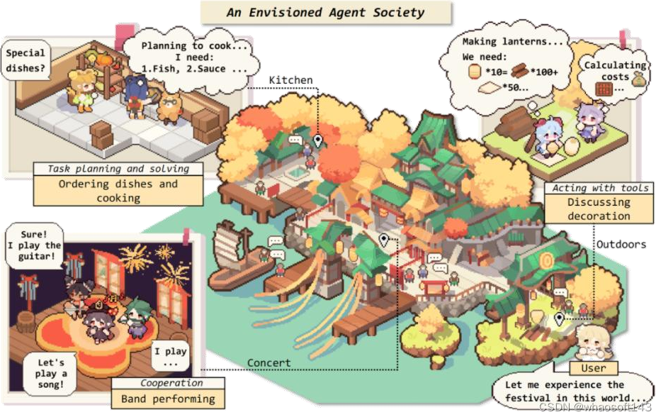
3 Challenges and Approaches of LLM ABM
Main Challenge: How to make agents behave close to real-world individuals with human knowledge and rules.
3.2 Aligning with human knowledge and rules
Human alignment
To align with human knowledge (domain-specific) and values
Prompt engineering & tuning
Personalization
To meet individual user preferences and needs
(E.g. users in recommender systems)
Prompt engineering & tuning
Heterogeneity
Prompt Engineering | Tuning
Not modifying the model itself Optimizing output through carefully designed inputs Better suited for quickly adapting to new tasks or specific scenarios. | Modifying the model’s internal parameters (weights). Requires domain-specific datasets and expert feedback. Better suited for tasks that require high specialization and long-term optimization.

Slide 64
3 Challenges and Approaches of LLM ABM
Main Challenge: How to make agents behave close to real-world individuals with human knowledge and rules.
3.3 How to Simulate Actions
Mimic human workflows (by planning)
Break down complex tasks into manageable sub-goals
Adapt their strategies and refine plans based on ongoing feedback and changing scenarios
Adjust based outcomes (by reflection)
Dual feedback systems
integrated evaluator relies on external outcomes (rewards, success, failure) to assess actions.
Self-Reflection via Prompts uses internal reasoning (self-assessment) to critique actions.
Past experience (by memory)
Design a memory system that functions as an external database for LLM agents
A systems organizing, updating, and retrieving information

Slide 65
3 Challenges and Approaches of LLM ABM
Main Challenge: How to make agents behave close to real-world individuals with human knowledge and rules.
3.4 Evaluating the Simulation
Realness validation with real human data
micro-level evaluation
evaluate the ability to simulate individual agent’s behavior or actions as realistically as possible.
macro-level evaluation
evaluate whether the simulated process has the same pattern, regularity, etc., as the real- world data.
generated behaviors rationality/via established benchmarks
Provide explanations for simulated behaviors
by analyzing explanations by LLM and comparing them with the human data or a well established theory or model
Ethics evaluation
bias and fairness
harmful words

Slide 66
04
Recent advances
in LLM agent-based modeling and simulation

Slide 67
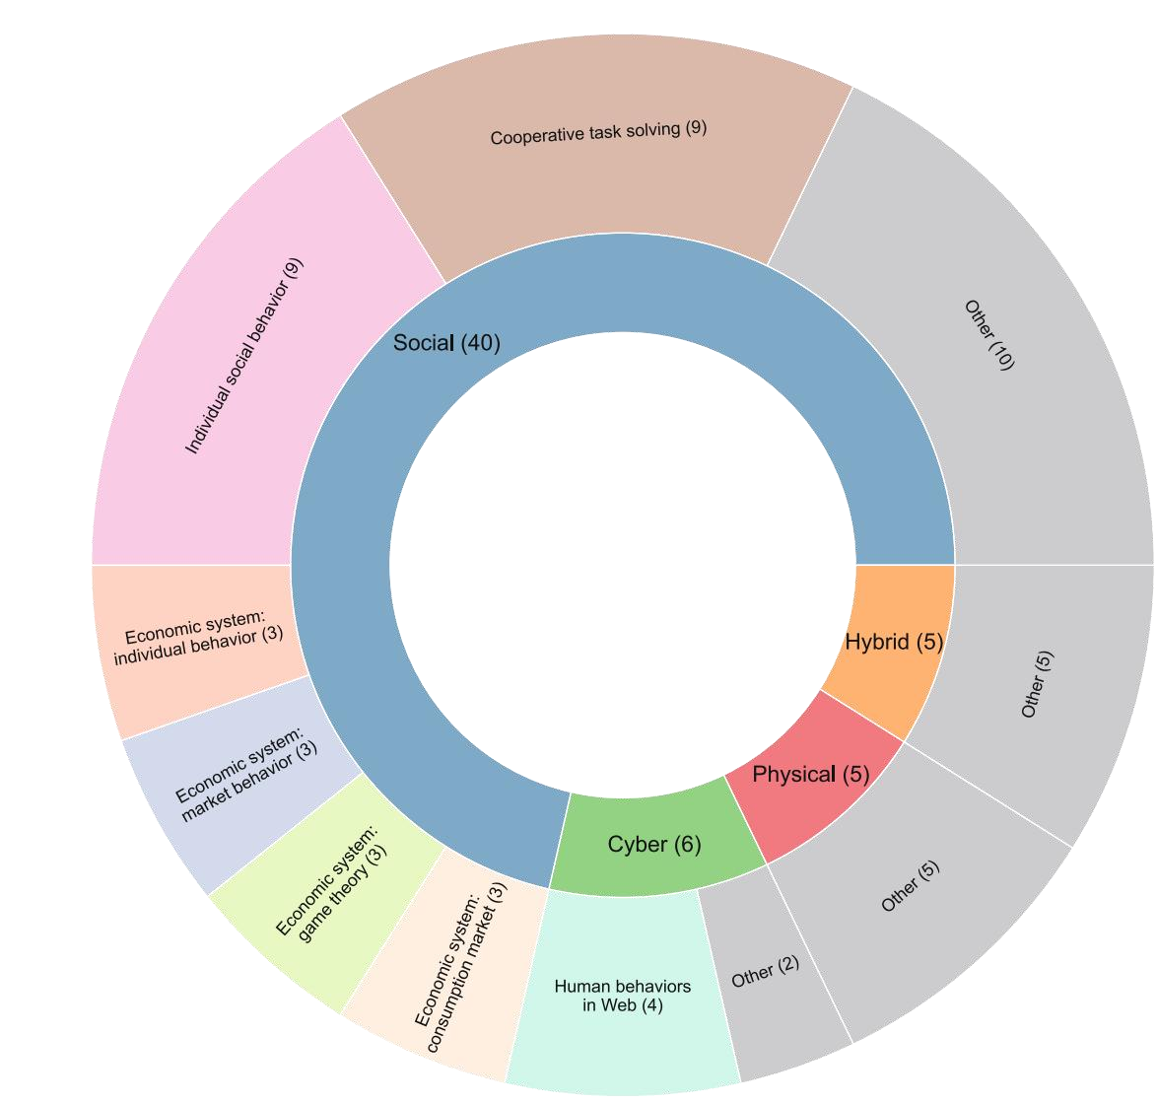
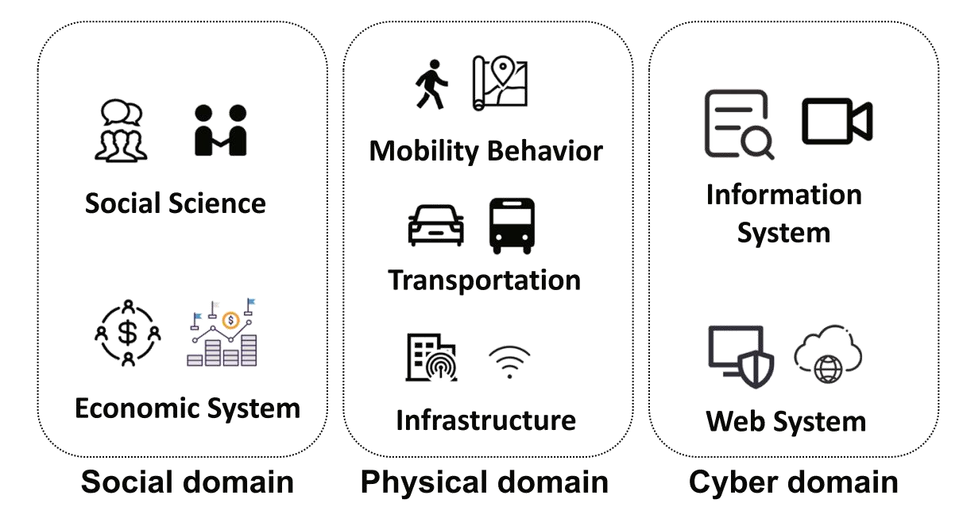
4 Recent Advances in LLM ABM
Typical Applications of LLM ABM...

Slide 68
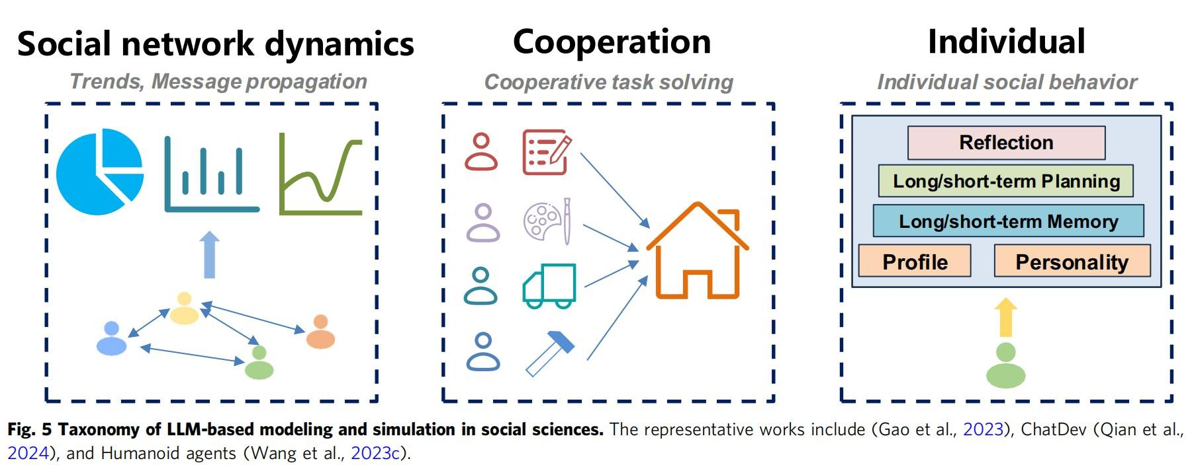
4 Recent Advances in LLM ABM
Social Domain
Social Sciences: Validating/Challenge Social Theories
Simulation of social network dynamics
Real-world social network data to initialize
Individual-level:
whether LLM agent can predict next label (positive/negative towards events).
Population-level evaluation:
whether the simulated results with LLM agents have the same trends as the ground-truth data
Simulation of cooperation
Design specific types of LLM agents, their roles, and the collaboration framework for certain tasks
Role-playing to finish one task.
analyzer, debater, summarizer
CEO, CTO, designers, programmers.
Simulation of individual social behavior
How to achieve closer approximation to real human responses
e.g. maintain internal state (stored in files) for agents including needs and emotions

Slide 69
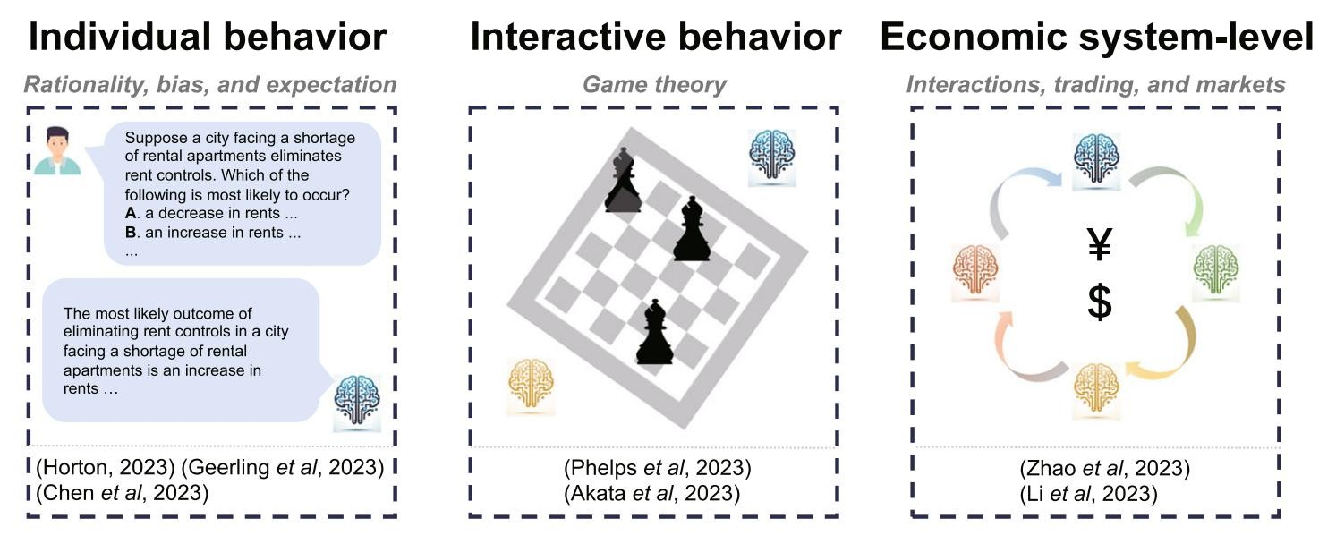
4 Recent Advances in LLM ABM
Social Domain
Economic System: categorized based on the number of agents involved
Individual economic behavior
To test the economic capabilities of LLMs (rational or irrational);
LLMs possess basic understanding of markets but lack precise perception for accurate prediction.
Interactive economic behavior simulation
Game theory
Study behavior of LLMs during game playing (cooperative and reasoning behavior).
Construct strong game-playing agents through prompt engineering.
GPT-4 shows better strategic reasoning ability and can converge to Nash equilibrium faster than other LLMs.
Economic system-level simulation
markets simulation, to investigate rationality or optimality of LLMs’ economic behaviors.

Slide 70
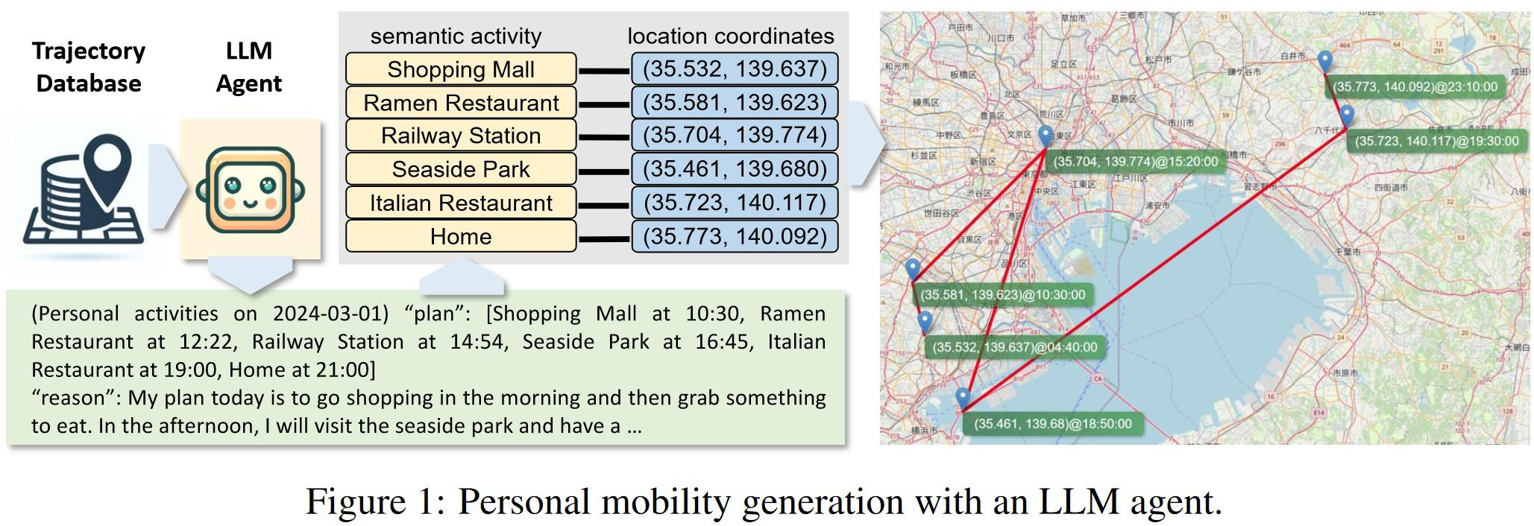
4 Recent Advances in LLM ABM
4.2 Physical Domain
Simulation of mobility behaviors
Foundation-Learning
Probe LLMs to extract representations of real-world locations and temporal events Get understanding of real-world space and time by LLMs
get substantial geospatial knowledge,
e.g. population density, asset wealth, education
Simulation
Huamn-like navigation behaviors
combine LLM with image-language alignment algorithms
route planning
Simulation for transportation
Driving behavior of human drivers
Simulation for wireless network
Simulate device users in the city infrastructure

Slide 71
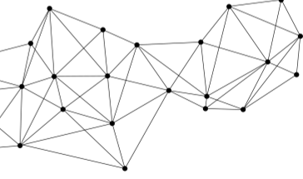
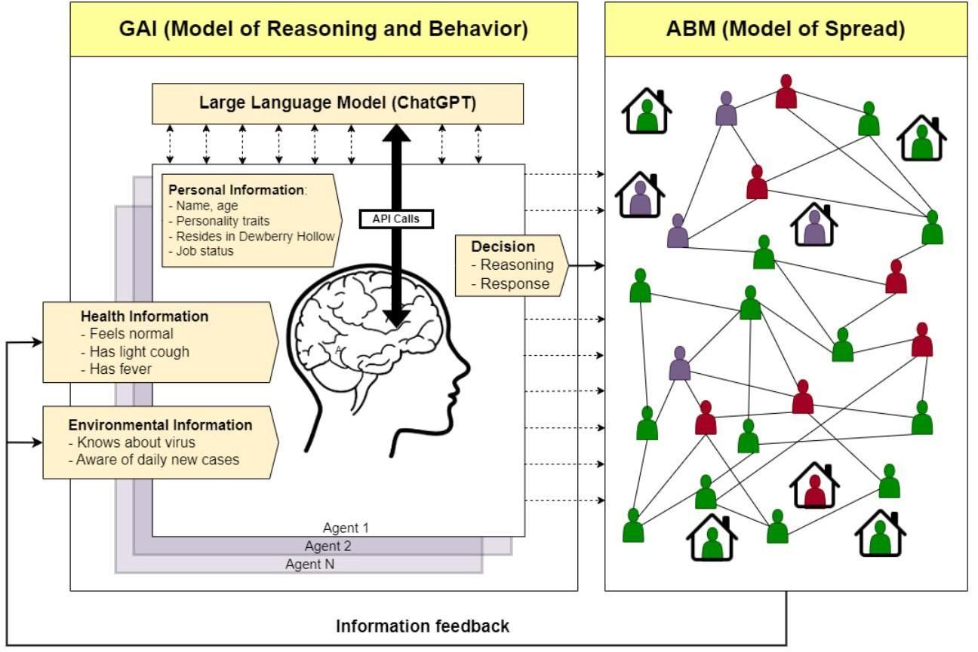
4 Recent Advances in LLM ABM
4.3 Cyber Domain
Simulation human behaviors in cyberspace
Include information (e.g. HTML data) access, website visitation/browsing, and network attack/defense
4.4 Hybrid Domain
Simultaneously consider more than one domain
Epidemic simulation
Simulation of LLM agents’ work and consumption behaviors in a macroeconomic market
produce correct Phillips curve, i.e., negative relationship btw unemployment rate and inflation
Urban Generative Intelligence (UGI)
platform; a real-world urban environment provided by digital twins; interface for agents
CityGPT, trained on city-specific multisource data
simulate various human behavior

Slide 72
05
Problems and future directions

Slide 73
5 Problems and Future Directions
Efficiency of Scaling up
Challenge: Simulating multiple LLM agents is computationally expensive, making large-scale societal simulations difficult.
Potential Solutions:
Memory footprint optimization
Model compression
Batch prompting
Shared message pools
Goal: Improve simulation speed and scalability to reveal emergent social behaviors.
5.2 Benchmarks
Current Issue: Existing benchmarks focus on LLM agents' decision-making and planning but lack proper evaluation for LLM-driven simulations.
Research Directions:
Develop quantitative & qualitative evaluation benchmarks for simulations.
Use LLM-driven simulations as AI training & evaluation environments (AI for Social Good).
Goal: Provide standardized tools for social science, policy-making, and AI evaluation.

Slide 74
5 Problems and Future Directions
5.3 Open Platforms
Current Gap: While open-source LLMs and agent frameworks exist, there are no dedicated open platforms for LLM-driven simulations.
Research Directions:
Develop open platforms to lower entry barriers and foster community growth.
Integrate LLM-driven agents with complex simulation environments (e.g., games, economic models).
Goal: Establish an open ecosystem to accelerate the adoption of LLM-based simulations.
5.4 Robustness & Stability
Major Challenges:
Adversarial attacks targeting LLM agent behavior.
Out-of-distribution generalization in diverse environments.
Reproducibility issues, as LLM agent behaviors can vary even with the same prompts.
Specialized LLMs optimized for agent-based simulations.
Hybrid models combining large LLMs with smaller, efficient ones.
Improved agent mechanisms for better stability and reduced response variability.
Goal: Enhance reliability and security in complex multi-agent settings
Potential Solutions:

Slide 75
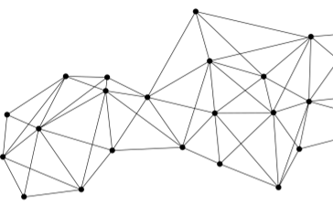
5 Problems and Future Directions
5.5 Ethical Risks
Key Concerns:
Misuse, bias, and harmful outputs from LLM-driven agents.
Value alignment & interpretability to ensure responsible AI behavior.
"Flattened caricature" issue in persona assignments.
Research Directions:
Improve LLM value alignment with human ethics and societal norms.
Design transparent and interpretable LLM agents.
Goal: Ensure safe, unbiased, and trustworthy LLM-driven agents.

Slide 76
Paper Sharing -4

Slide 77

LLM4SR: A Survey on Large Language Models for Scientific Research
Reporter: Zhang Jinchi 224030207
Date: 2025. 3.27

Slide 78
Introductions to LLM4SR
LLMs for Scientific Hypothesis Discovery
LLMs for Experiment Planning and Implementation
LLMs for Scientific Paper Writing
LLMs for Peer Reviewing
Conclusion
Framework

Slide 79
Introductions to LLM4SR

Slide 80
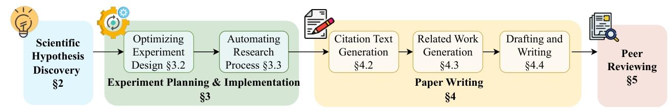
Introductions to LLM4SR
Schematic overview of the scientific research pipeline
This cyclical process has led to groundbreaking advance- ments in modern science and technology, yet it remains constrained by the creativity, expertise, and finite time and resources available inherent to human researchers.
LLMs have the potential to revolutionize each stage of the research cycle, offering unprecedented support and efficiency. This survey explores how LLMs are applied across four critical stages.

Slide 81
LLMs for Scientific Hypothesis Discovery

Slide 82
LLMs for Scientific Hypothesis Discovery
History of Scientific Discovery
Literature-based Discovery:
Limitations： Contextual Insensitivity, Discrete Concept Focus, Narrow Applicability, Manual Validation Burden.
Inductive Reasoning :
Limitations: Lack of Novelty, Contextual Constraints, Verification Challenges.
LLM Advancements : Contextual Grounding, Automated Evaluation.

Slide 83
LLMs for Scientific Hypothesis Discovery
Development of Methods
Main Trajectory:
Integrating Key Components: Inspiration Retrieval Strategy, Feedback Modules, Evolutionary Algorithm, Multi-Inspiration Leverage, Hypothesis Ranking, Automatic Research Question Construction
These advancements enable more scalable, context-aware, and empirically grounded hypothesis generation, laying the foundation for autonomous scientific discovery.

Slide 84
LLMs for Scientific Hypothesis Discovery
Evaluation Development Trend
Criteria: Novelty, Validity, Clarity; Significance, Feasibility, and Relevance.
Evaluator Selection: LLM-based Evaluation, Expert-based Evaluation
Evaluation Approaches: Direct Evaluation, Reference-based Evaluation, Comparison-based Evaluation.
Future Directions: Multi-dimensional Frameworks: Combine expert feedback, LLM analysis, and experimental data.

Slide 85
LLMs for Scientific Hypothesis Discovery
Major Progresses/Achievements
First Expert Validation
LLMs can generate novel and valid social science hypotheses, verified by PhD experts.
Large-Scale Human Study
LLMs generated hypotheses with higher novelty than human researchers (p < 0.01) but slightly lower validity (5–8% gap), highlighting trade-offs between creativity and accuracy.
Cross-Domain Rediscovery
LLMs trained on pre-2023 data rediscovered 89% of hypotheses from 2024 high-impact chemistry papers (e.g., Nature), showcasing latent knowledge integration.

Slide 86
LLMs for Scientific Hypothesis Discovery
Challenges and Future Work
Challenges
Validation Bottlenecks
LLM Limitations: Hypothesis quality is constrained by model capacity (e.g., GPT-4 > LLaMA-2), with unclear internal reasoning structures.
Interdisciplinary Gaps: Overreliance on external knowledge retrieval lacks human-like logical reasoning.
Future Directions
Automated Experimentation
Enhanced LLM Reasoning
Interdisciplinary Theory

Slide 87
LLMs for Experiment Planning and Implementation

Slide 88
LLMs for Experiment Planning and Implementation
Optimizing Experimental Design
Task Decomposition
LLMs break down complex tasks into smaller, manageable sub-tasks to ensure alignment with specific research goals.
Dynamic Feedback
A process that allows them to continuously evaluate and improve experimental plans.
LLMs simulate expert discussions through collaborative dialogue, challenging assumptions and refining outputs iteratively, mirroring real-world scientific problem-solving where diverse perspectives drive deeper exploration and consensus.

Slide 89
LLMs for Experiment Planning and Implementation
Automating Experimental Processes
Data Preparation
Automated Tasks: Data cleaning , labeling, feature engineering, and synthetic data generation.
Experiment Execution and Workflow Automation
LLM-based agents can acquire task-specific capabilities through a combination of pretraining, fine-tuning, and tool-augmented learning.
Data Analysis and Interpretation
LLMs assist in data analysis by generating natural language explanations and constructing meaningful visualizations.

Slide 90
LLMs for Experiment Planning and Implementation
Challenges & Future Directions
Challenges
Planning Limitations: LLMs struggle with complex task dependencies and hallucinations.
Prompt robustness: Minor variations in prompt wording can result in inconsistent guidance throughout the planning and execution process
Efficiency Bottlenecks: Slow autoregressive processing impacts real-time feedback.
Future Directions
Robust Verification: Integrate external tools (e.g., simulators) to validate outputs.
Improve Prompt Robustness: Developing adaptive systems that monitor and modify prompt structures in response to contextual changes, ensuring consistency across planning stages
Efficient Models: Develop distilled or hybrid architectures (LLM + lightweight models).

Slide 91
LLMs for Experiment Planning and Implementation
HuggingGPT: Automated Scientific Research Platform
Key Functions:
Task Decomposition & Coordination: Breaks down complex tasks (e.g., hypothesis generation, experiment design) into subtasks and dynamically selects the best models.
Multi-Model Collaboration: Integrates 200+ pre-trained models (e.g., BERT, GPT-4) for cross-disciplinary research.
Cross-Domain Capabilities
Experiment Design Optimization
How to use:
No Coding Required: Use natural language prompts via the Hugging Face platform.
Link: https://huggingface.co/spaces/HuggingGPT

Slide 92
LLMs for Scientific Paper Writing

Slide 93
LLMs for Scientific Paper Writing
Citation Text Generation
Combining citation network structures with textual context to produce contextually relevant and semantically rich citation texts.
Related Work Generation
LLMs generate related work sections by leveraging Retrieval-Augmented Generation (RAG) and structured templates, reducing hallucinations and improving logical coherence in literature reviews.
Drafting and Writing
LLMs enable automated scientific writing through tools like PaperRobot (incremental drafting), CoAuthor (collaborative writing), and AI Scientist (full autonomy), enhancing efficiency and collaboration in generating research papers.

Slide 94
LLMs for Scientific Paper Writing
Challenges & Future Directions
Challenges
Hallucinations
Limited Context Window
Scientific Rigor
Ethical Risks
Future Directions
Enhanced Retrieval & Verification
Enhanced Multi-Document Synthesis
Domain-Specific Fine-Tuning
Ethical Guidelines

Slide 95
LLMs for Scientific Paper Writing
LitLLM: Automated Scientific Literature Review Tool
Key Functions:
Intelligent Literature Review: Generate structured reviews by inputting keywords/questions, integrating cutting-edge research.
Multi-Model Compatibility
Retrieval-Augmented Generation (RAG)
Multilingual & Cross-Disciplinary
Code & documentation: https://github.com/facebookresearch/LitLLM

Slide 96
LLMs for Peer Reviewing

Slide 97
LLMs for Scientific Paper Writing
Automated Peer Review Generation
Single-Model Architectures: Use sophisticated prompting or knowledge graphs (ReviewRobot) for structured reviews.
Multi-Model Architectures: Leveraging multiple specialized models to handle different aspects of the review process.
LLM-assisted Peer Review Workflows
Information extraction and summarization function: Automate document understanding and synthesis to support reviewer comprehension.
Manuscript validation and quality assurance function: Operate at different levels of analysis to ensure scientific rigor.
Review writing support function: Take different yet complementary approaches to assist reviewers at various expertise levels.

Slide 98
LLMs for Scientific Paper Writing
Challenges & Future Directions
Challenges
Domain-Specific Knowledge Gaps
Algorithmic Bias
Homogenization of Feedback: Overreliance on standardized LLM systems may reduce review diversity.
Future Directions
Domain-Specific Models
Robust Governance Mechanisms: Establish standards for detecting AI-generated content to prevent misconduct. Creat Standardized protocols to securely integrate LLM review tools into existing journal platforms.

Slide 99
Conclusion

Slide 100
Conclusion
Transformative Impact: LLMs enhance scientific productivity across hypothesis generation, experimentation, writing, and peer review, enabling interdisciplinary innovation.
Technical Challenges: Validation bottlenecks, domain adaptation limitations, hallucinations, and logical inconsistencies constrain LLM effectiveness.
Future Directions:
Develop automated lab systems and domain-specific models.
Integrate symbolic logic and knowledge graphs to improve reasoning.
Establish ethical frameworks and transparent human-AI collaboration protocols.

